Slide 1

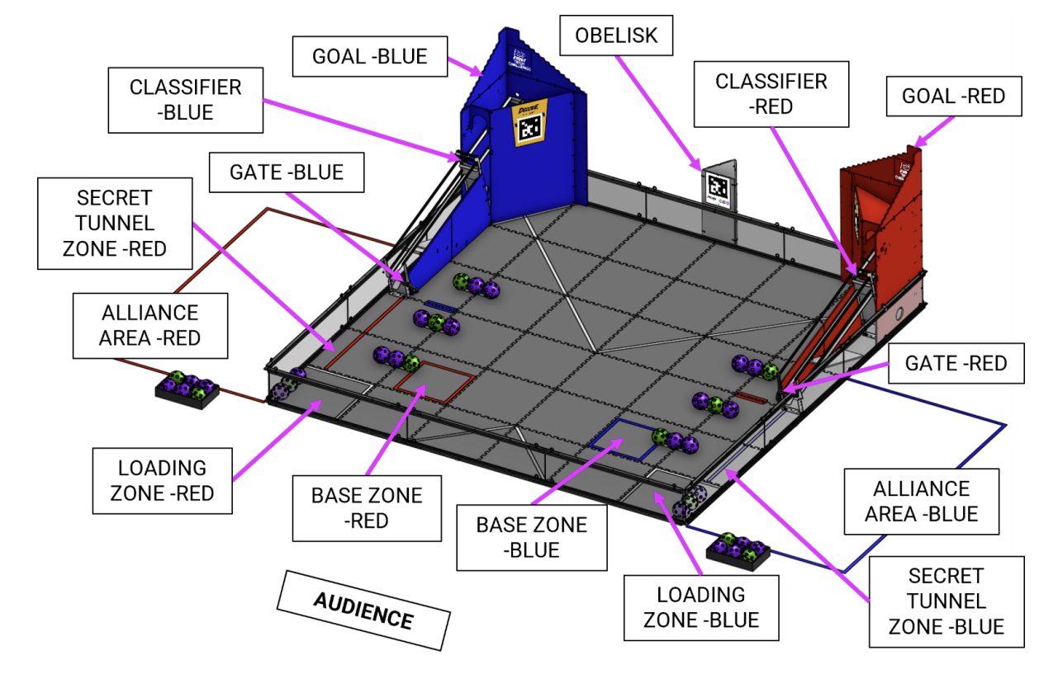
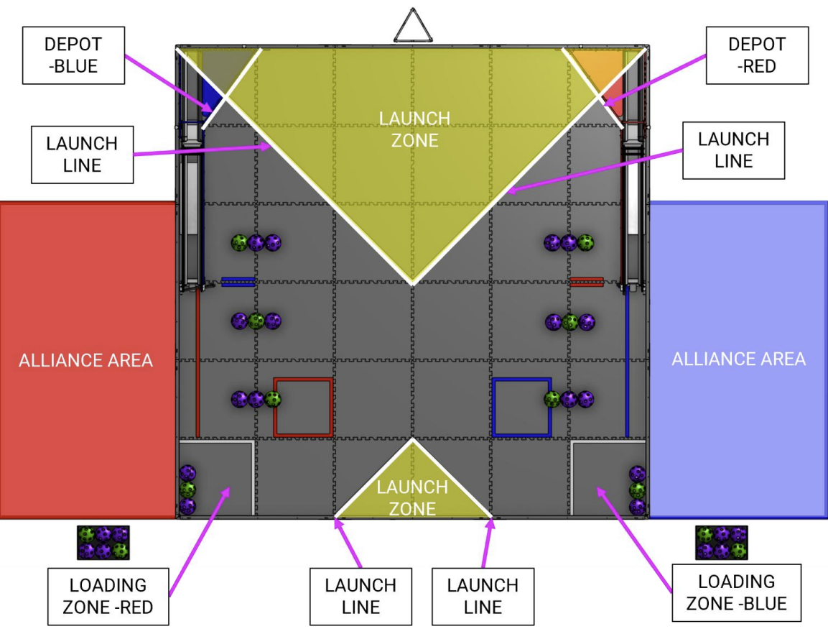
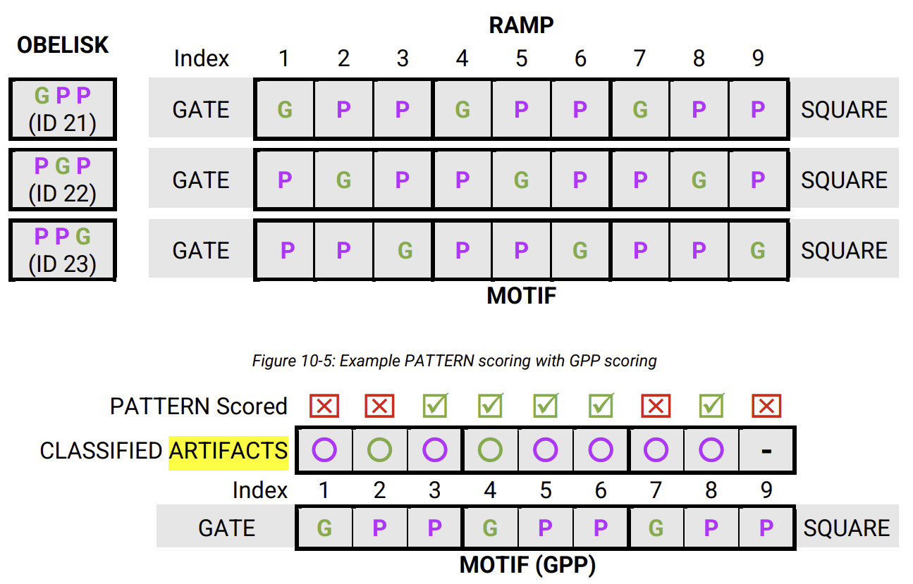
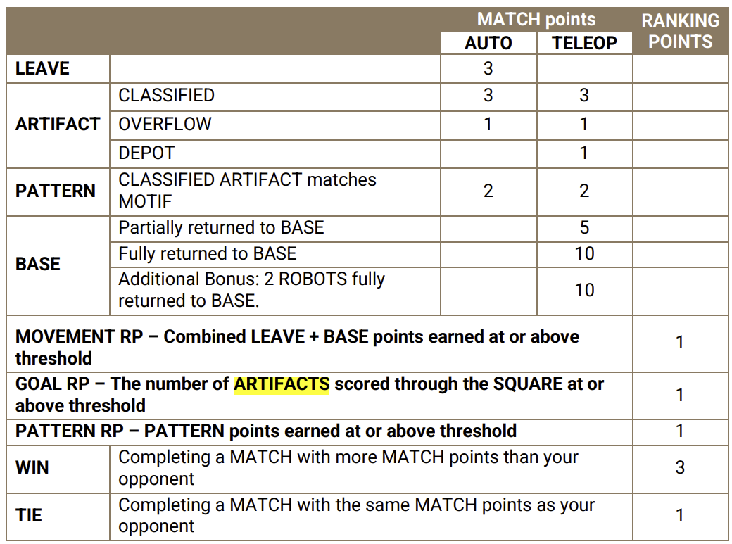
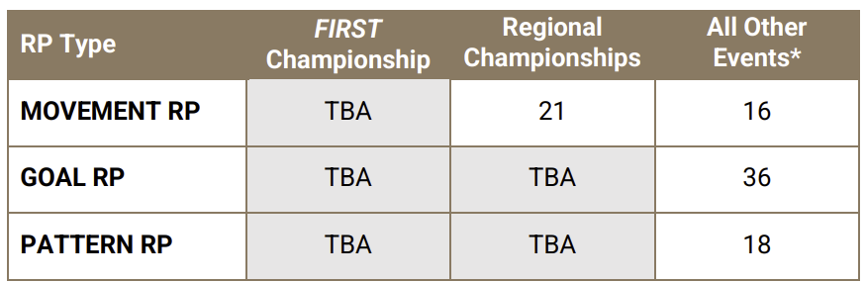
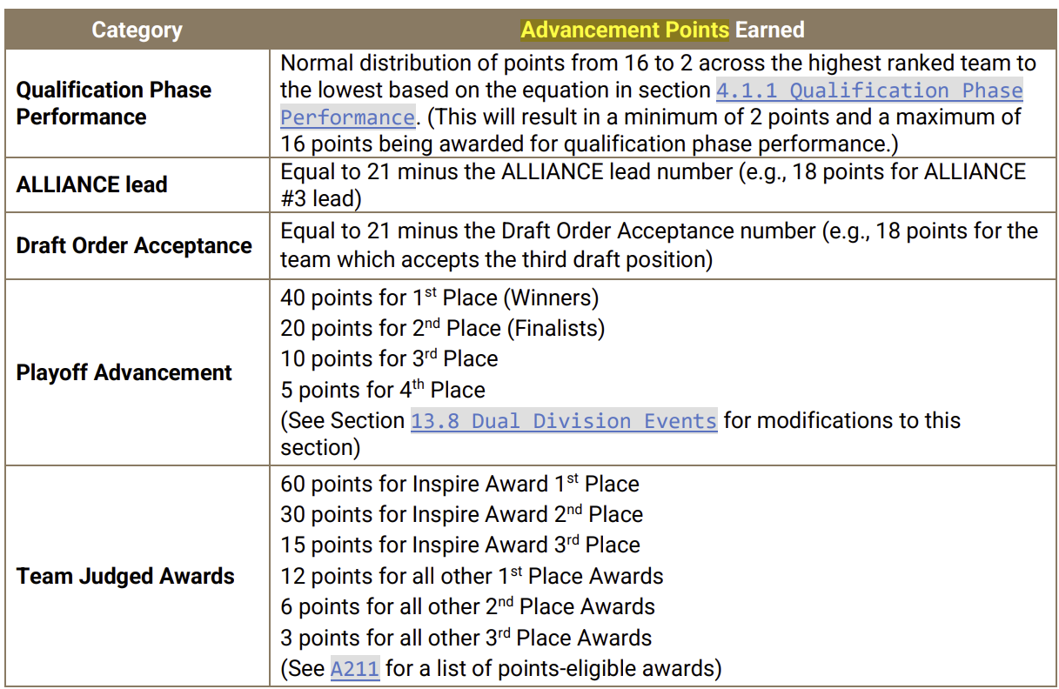
The Game: In DECODE presented by RTX, two alliances of two teams each score purple and green ARTIFACTS in their GOAL, build PATTERNS, and race back to their BASE before time runs out (Section 8). There are 24 purple and 12 green ARTIFACTS total in a DECODE MATCH.
Just before the match starts, the OBELISK is randomized to show one of 3 MOTIFS. The MOTIF for the MATCH defines what color PATTERN robots try to create on their RAMPS.
Matches have two distinct periods of play: a 30-second Autonomous period followed by a two-minute Driver-Controlled period.
Autonomous Period:
During AUTO, the first 30 seconds of the MATCH, DRIVERS may not provide input to their ROBOTS, so ROBOTS operate with only their pre-programmed instructions (11.4.1). Two ALLIANCES of 2 teams each score purple and green ARTIFACTS in their GOAL, and build PATTERNS. ROBOTS can earn points by scoring ARTIFACTS in their GOAL and building a PATTERN on their RAMP based on the MOTIF. ROBOTS also earn points for moving off the LAUNCH LINE.
Driver Controlled Period:
During the TELEOP period, which lasts for 2 minutes, DRIVERS remotely operate ROBOTS to score points. DRIVE TEAM members can retrieve ARTIFACTS from the ALLIANCE’S LOADING ZONE and help their ROBOTS by loading them with ARTIFACTS.
Robots conclude the MATCH by returning to their BASE.
Ver 1.0.3
8013 - Kuiper

